Slide 1




NEXT GEN EMPLOYABILITY PROGRAM
Creating a future-ready workforce
Team Members
College Name
Arunachala college of engineering for women.
Student Name :S.Sahana
Student ID : au960221104099

Slide 2

CAPSTONE PROJECT SHOWCASE
Project Title
Car Rentals Application with Django Framework
Abstract | Problem Statement | Project Overview | Proposed Solution | Technology Used | Modelling & Results | Conclusion

Slide 3
Abstract
Car rental application is a web-based application that allows users to search for and rent cars. The application is built using the Django framework, which is a Python web framework. The application is built using the Django framework, which is a Python web framework. The application is hosted on a cloud-based server, which means that it is accessible from anywhere in the world. Overall, this car rental application is a well-designed and easy-to-use application that allows users to search for and rent cars online.
Source :

Slide 4
Problem Statement
Some problem statements for a car rental application built with the Django framework:
Customers should be able to view the available cars that can be rented on an hourly, daily, or weekly basis.
Customers should be able to select from a few options before making a booking.
Customers should be able to register and reserve automobiles online.
The user interface should be interactive and easy to use.
The application should maintain the quality of the service.
If you are interested in building a car rental application with Django, there are many resources available online.
Source :

Slide 5
Project Overview
A car rental application built with the Django framework typically includes a customer model that stores customer details, a vehicle model that stores vehicle details, and a reservation model that stores reservation details. Django is a high-level Python web framework that follows the Model-View-Controller (MVC) architecture. It is free and open-source, and it is one of the most popular web frameworks in the world. Django is known for its speed, security, and scalability. The Car Rental System Django Project is a web app that allows customers to register, search for vehicles, and manage orders.
Source :

Slide 6
Proposed solution
Create a Django project.:Done using the django-admin startproject command
Create a Django app:This can be done using the python manage.py startapp command.
Define the models.: The models will represent the different entities in the car rental system, such as cars, customers, and reservations.
Create the templates.: The templates will be used to render the HTML pages that the user will see.
Configure the URLs.: The URLs will map the different paths in the system to the appropriate views.
Run the development server.: This can be done using the python manage.py runserver command.
Source :

Slide 7
Additional features
A user authentication system: This would allow users to create accounts and log in to the system.
A payment processing system: This would allow users to pay for their reservations online.
An email notification system: This would allow users to receive email notifications when their reservations are confirmed or cancelled.
A reporting system: This would allow administrators to generate reports on the car rental business, such as the most popular cars and the most profitable rental periods.
Source :

Slide 8
Key components
User Authentication: Secure user login and registration.
Vehicle Inventory Management: Database for available vehicles.
Booking System: Reservation functionality for users.
Payment Integration: Secure online payment processing.
Geolocation Services: Location-based search and maps.
Admin Dashboard: Management interface for administrators.
Email Notifications: Automated communication for users and admins.
Reviews and Ratings: Feedback system for users.
Search and Filtering: Efficient vehicle discovery for users.
Responsive Design: Optimized for various devices.
Source :

Slide 9


Technology Used
Front-end
Back-end
Source :

Slide 10
Modelling & Results
Modeling:
User Model: Represents users of the application
Car Model: Represents details about each car available for rental.
Booking Model: Represents bookings made by users.
Result:
User Authentication:Implemented for user registration,login andlogou logout.
Car Listings: Users can view available cars with details like make, model, and price.
Booking System: Users can select a car, choose pickup and return dates.
Admin Panel: Provides an admin interface for managing cars, users, and bookings
User Profile: Users can, edit their profile details, and change their password.
Search Functionality:Users can search for cars based on various criteria .
Responsive Design: The application is designed to be responsive, ensuring optimal user experience across different devices.
Source :

Slide 11
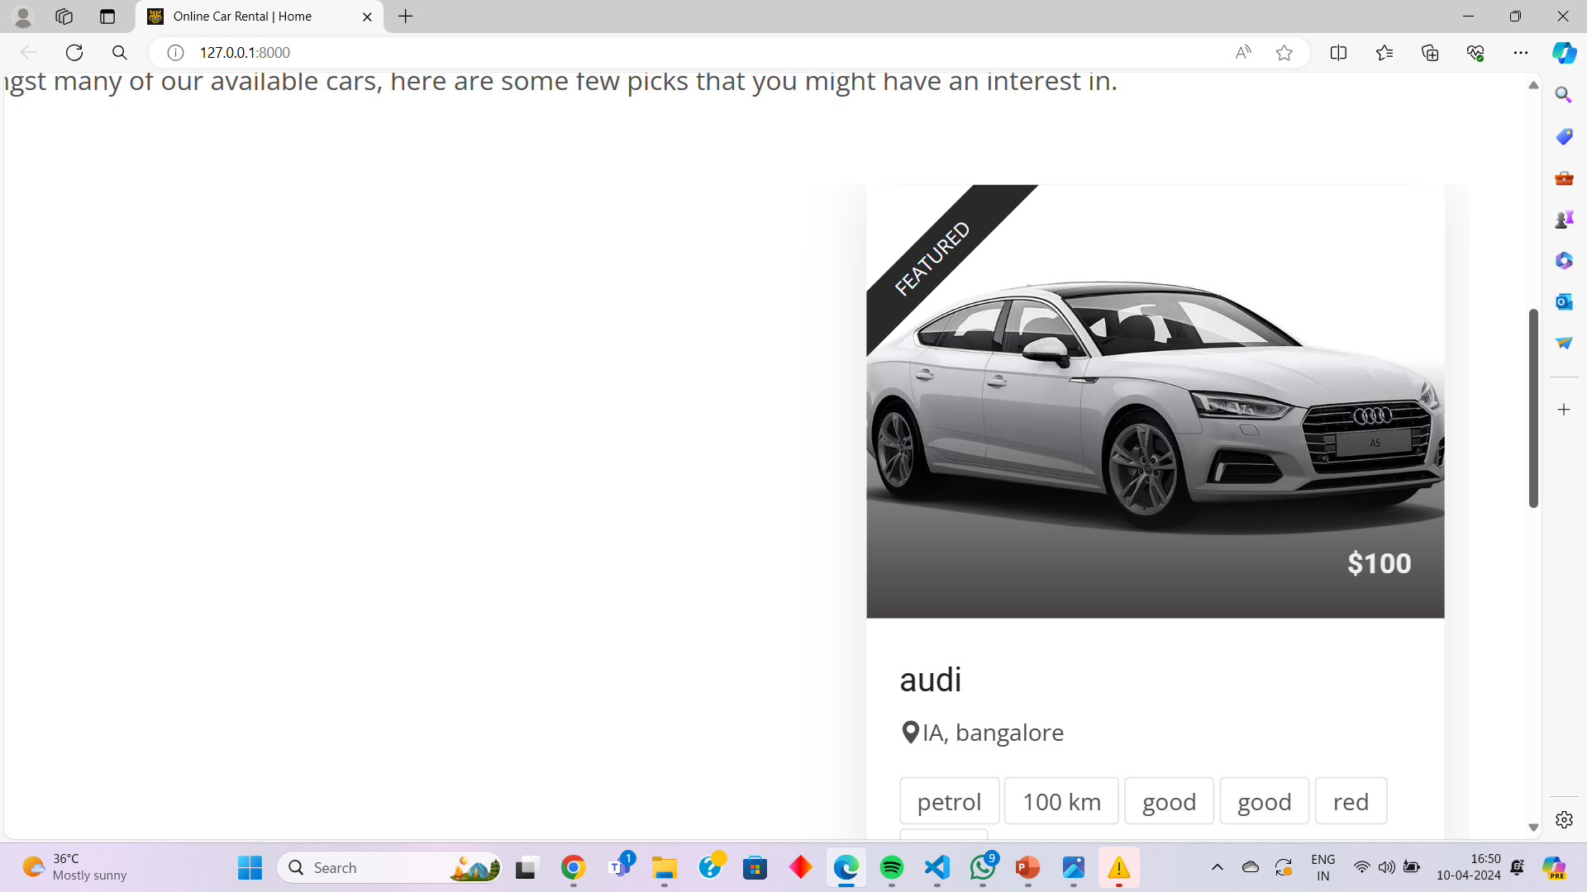
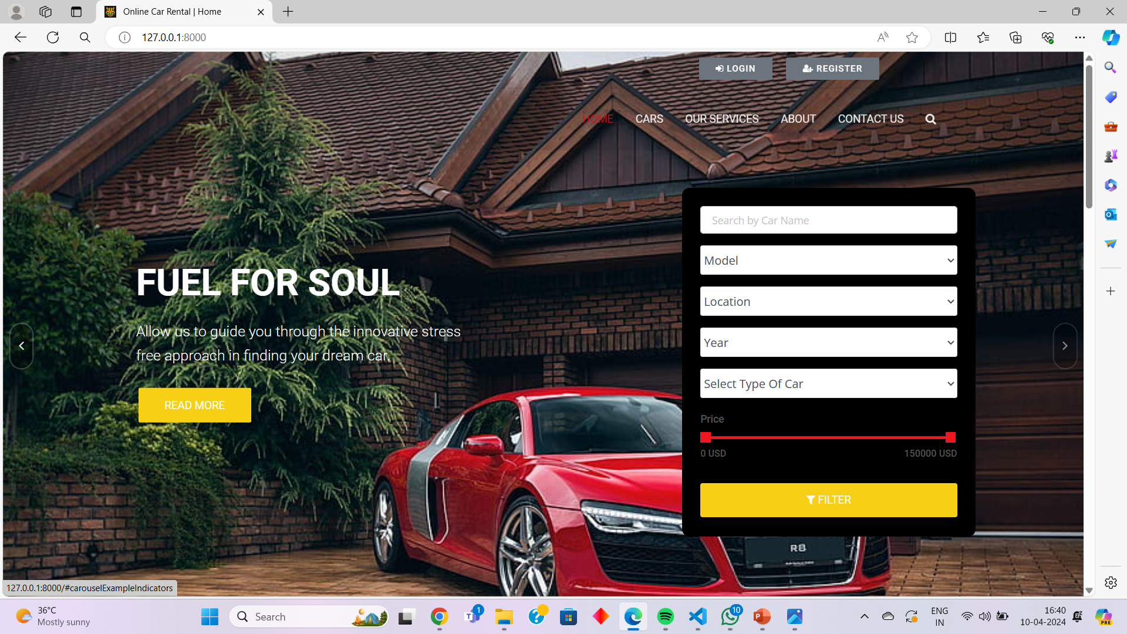
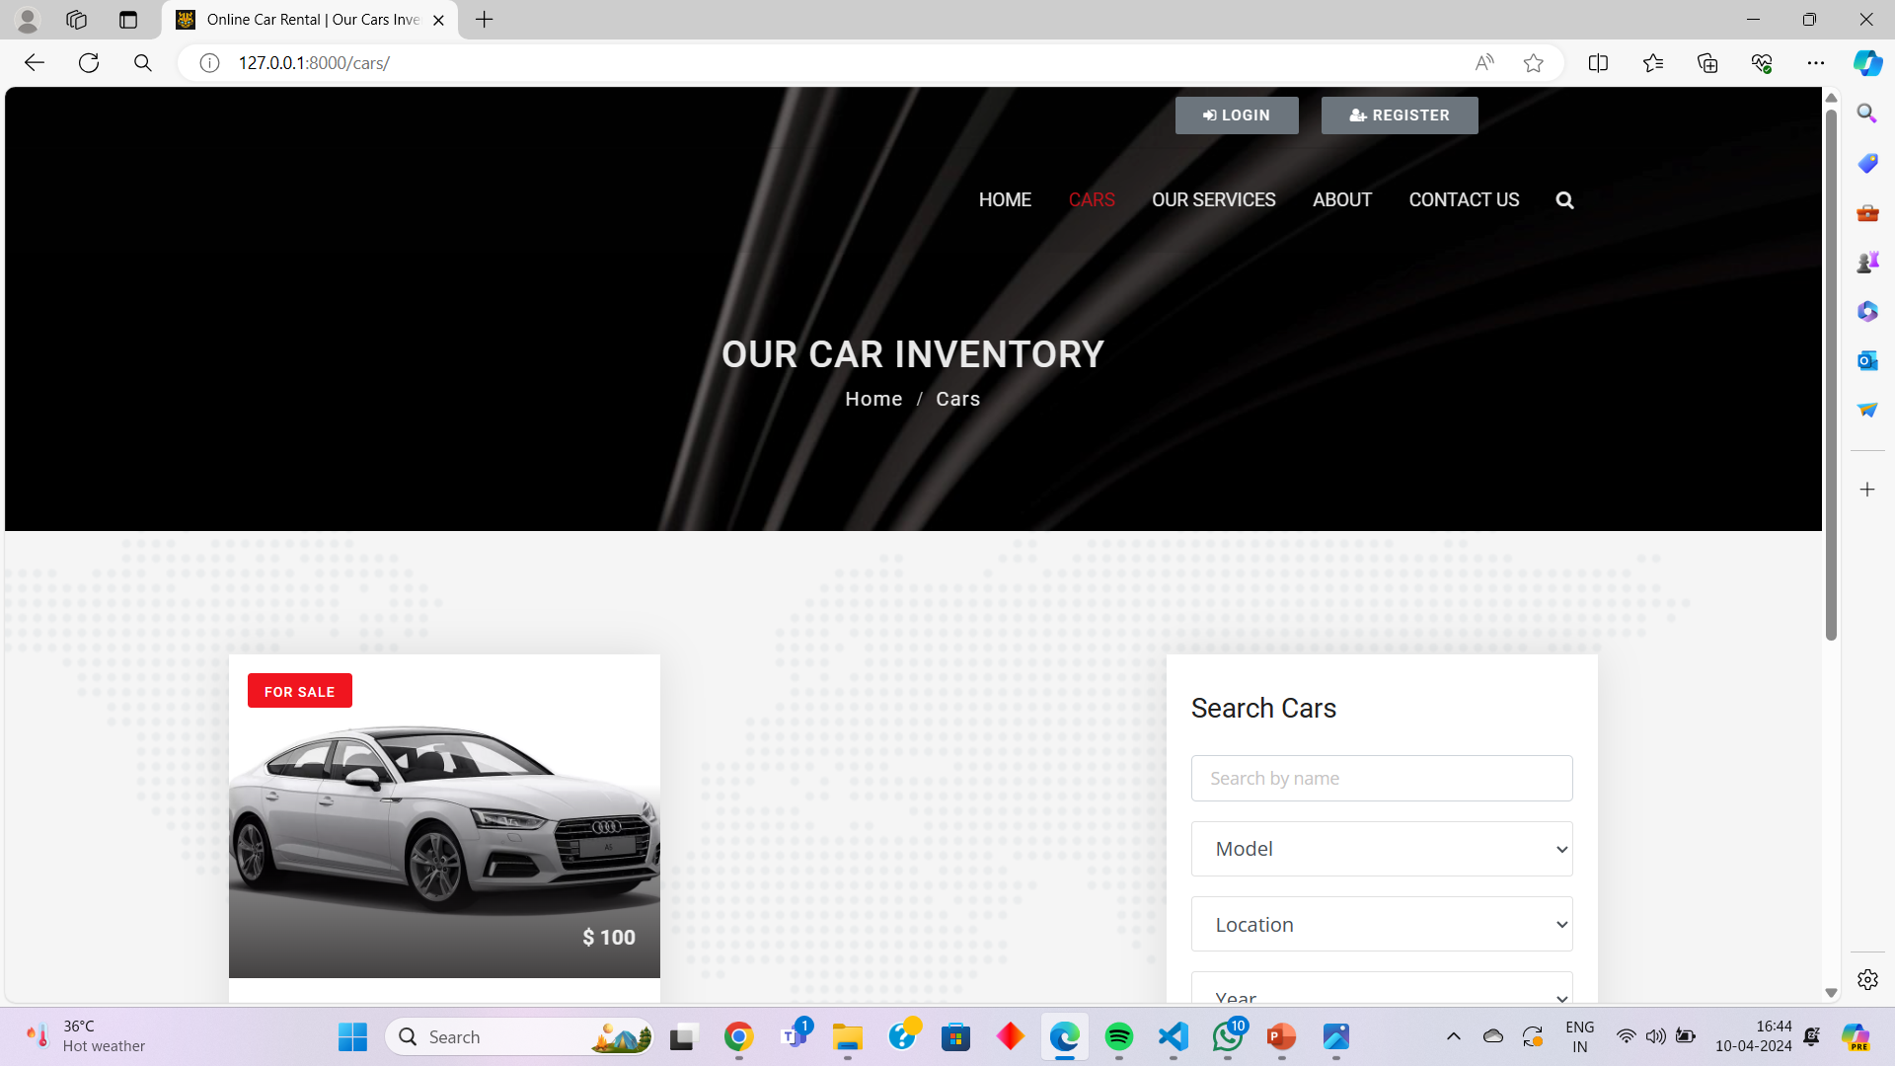
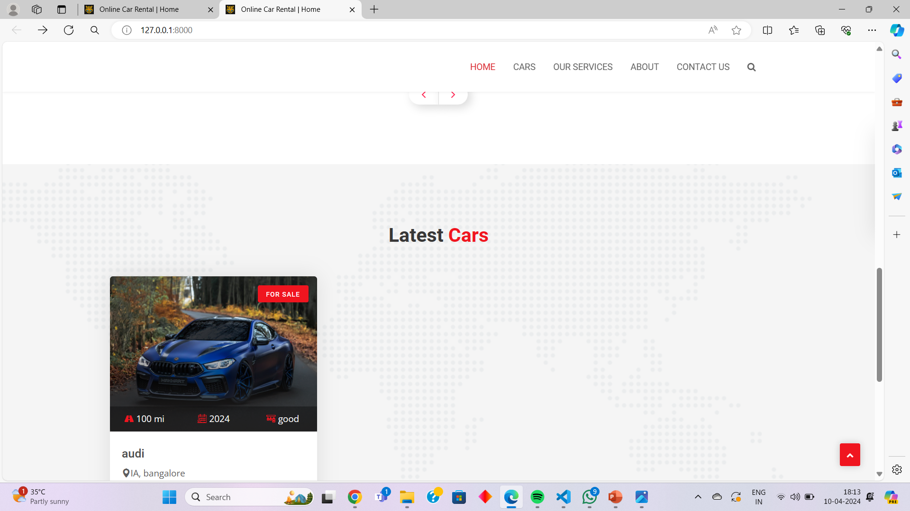
Homepage

Slide 12
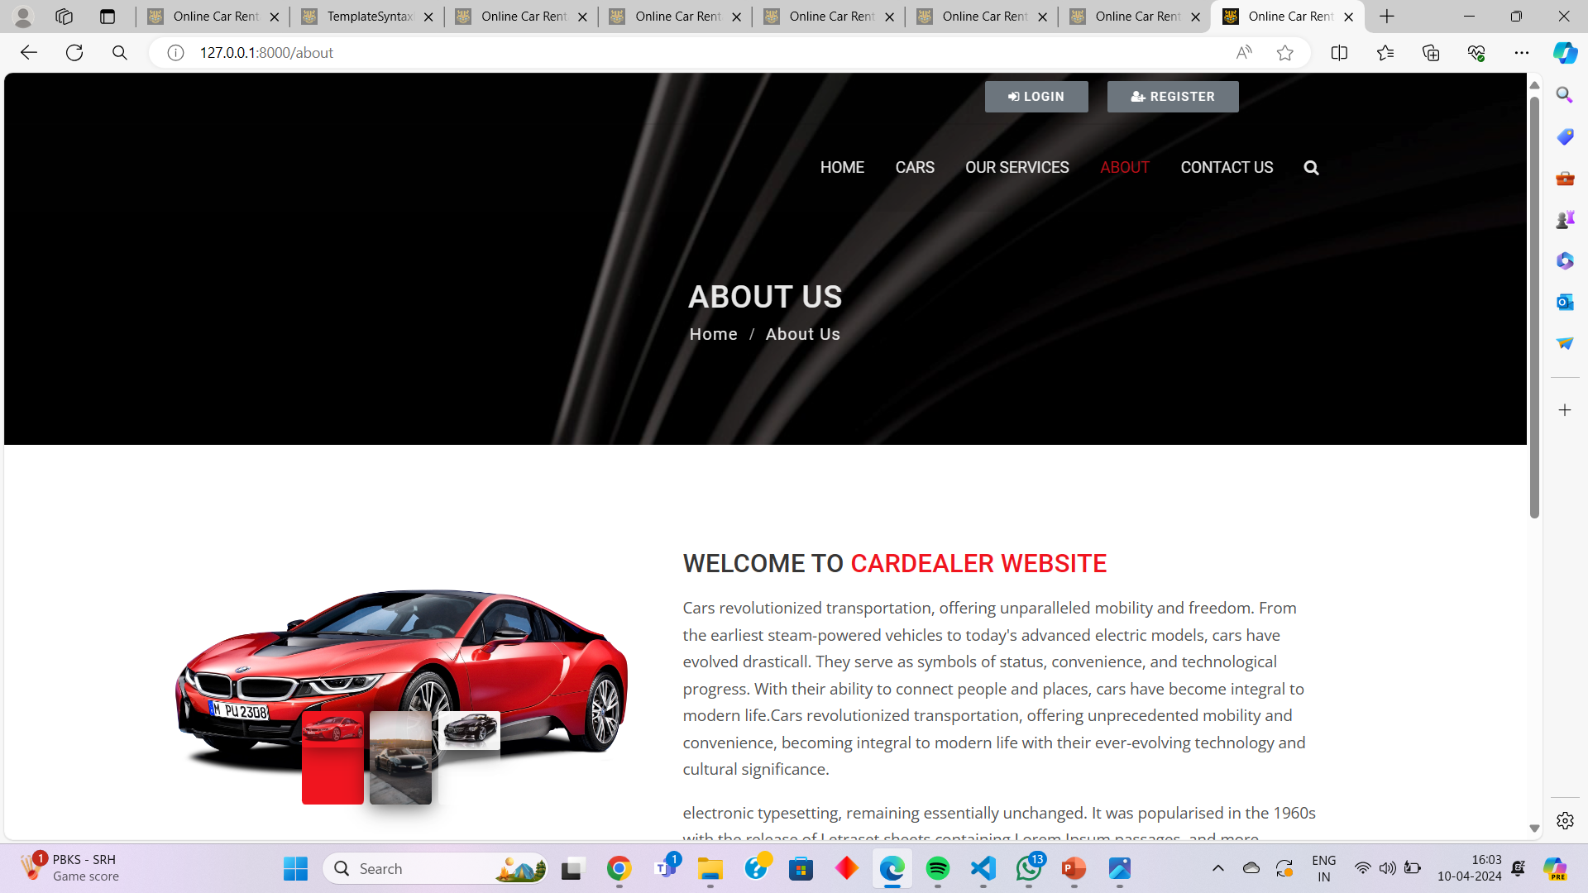
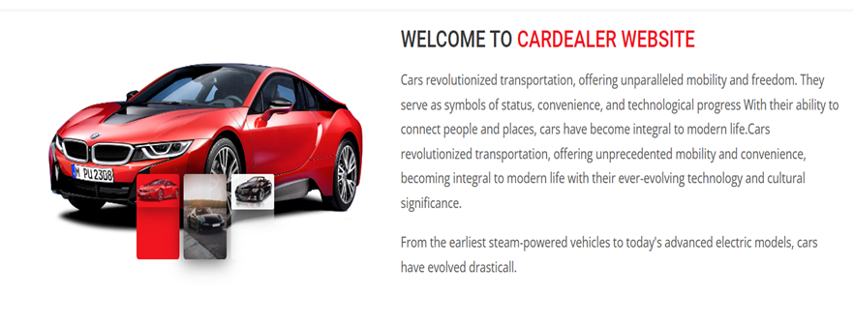
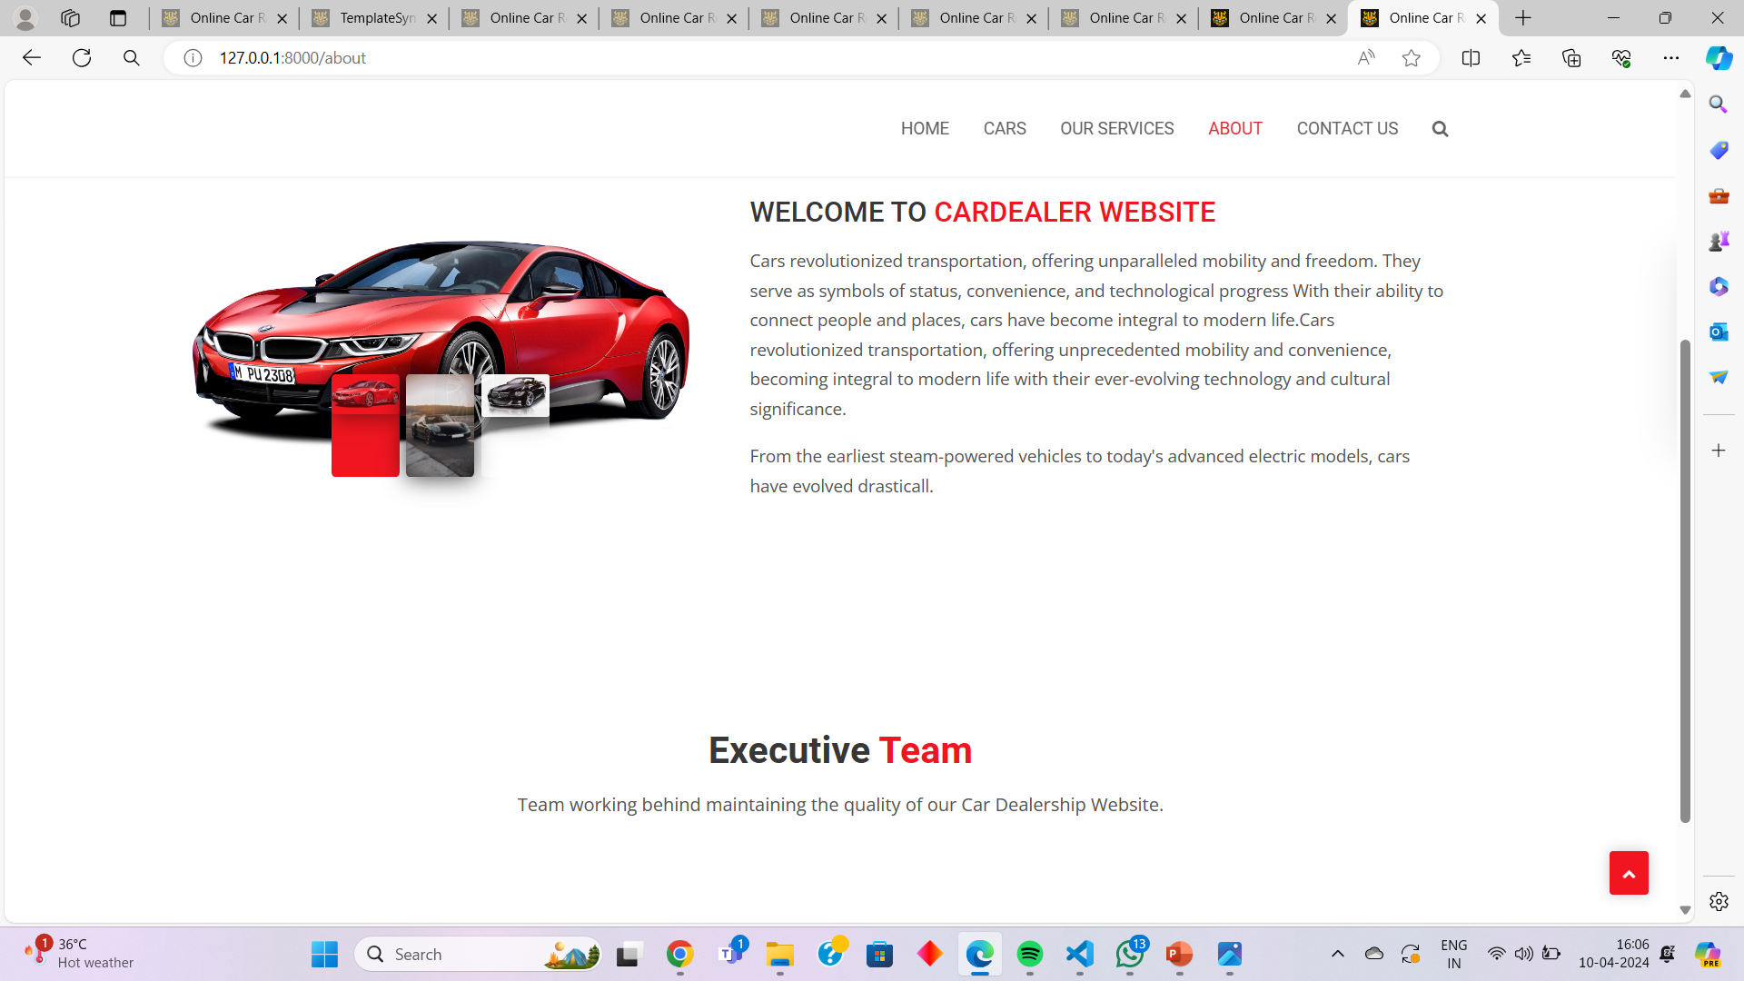
About-Us-Page

Slide 13
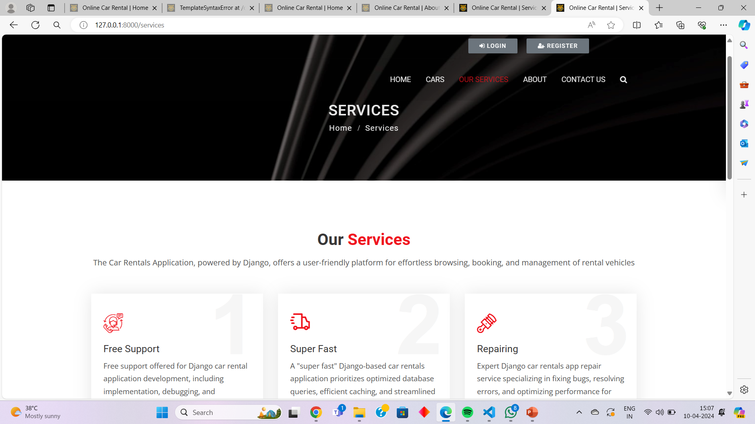
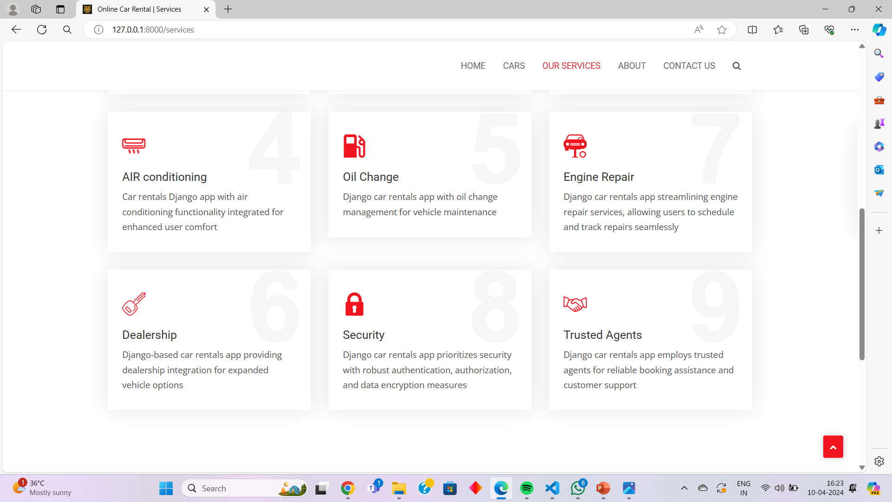
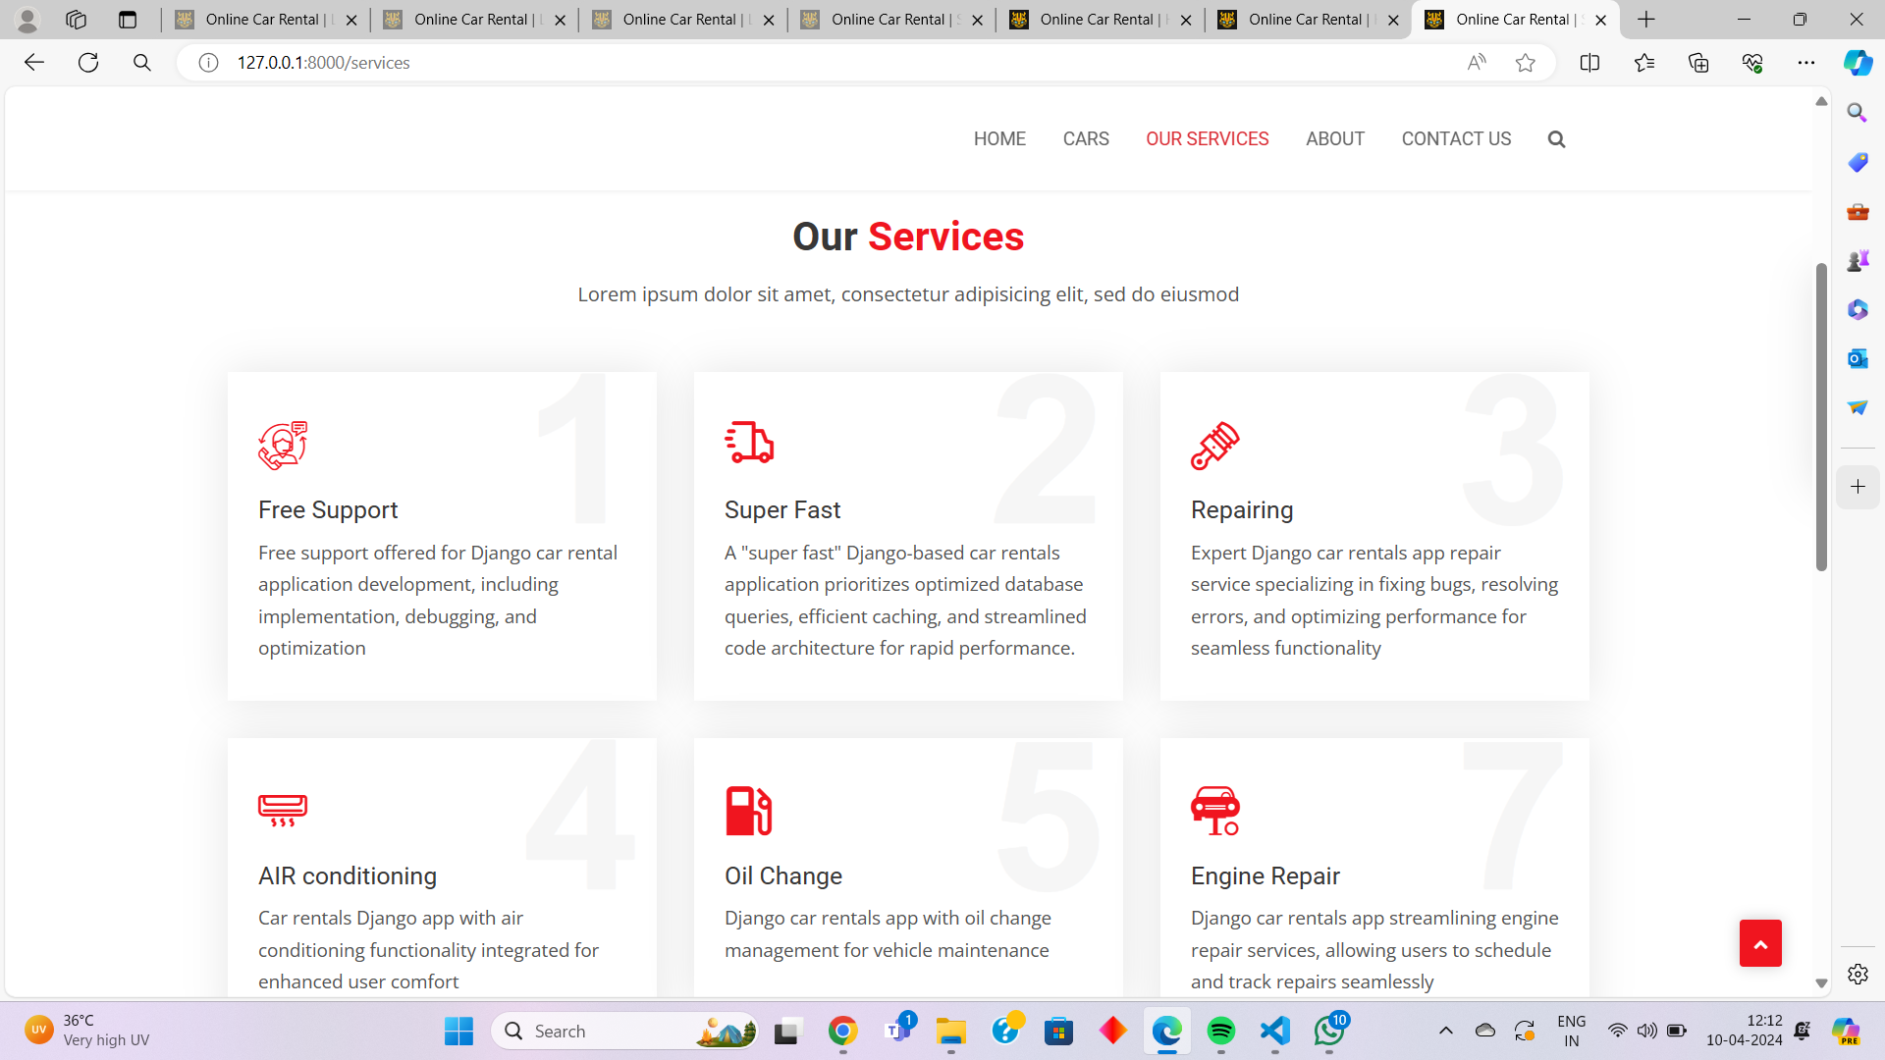
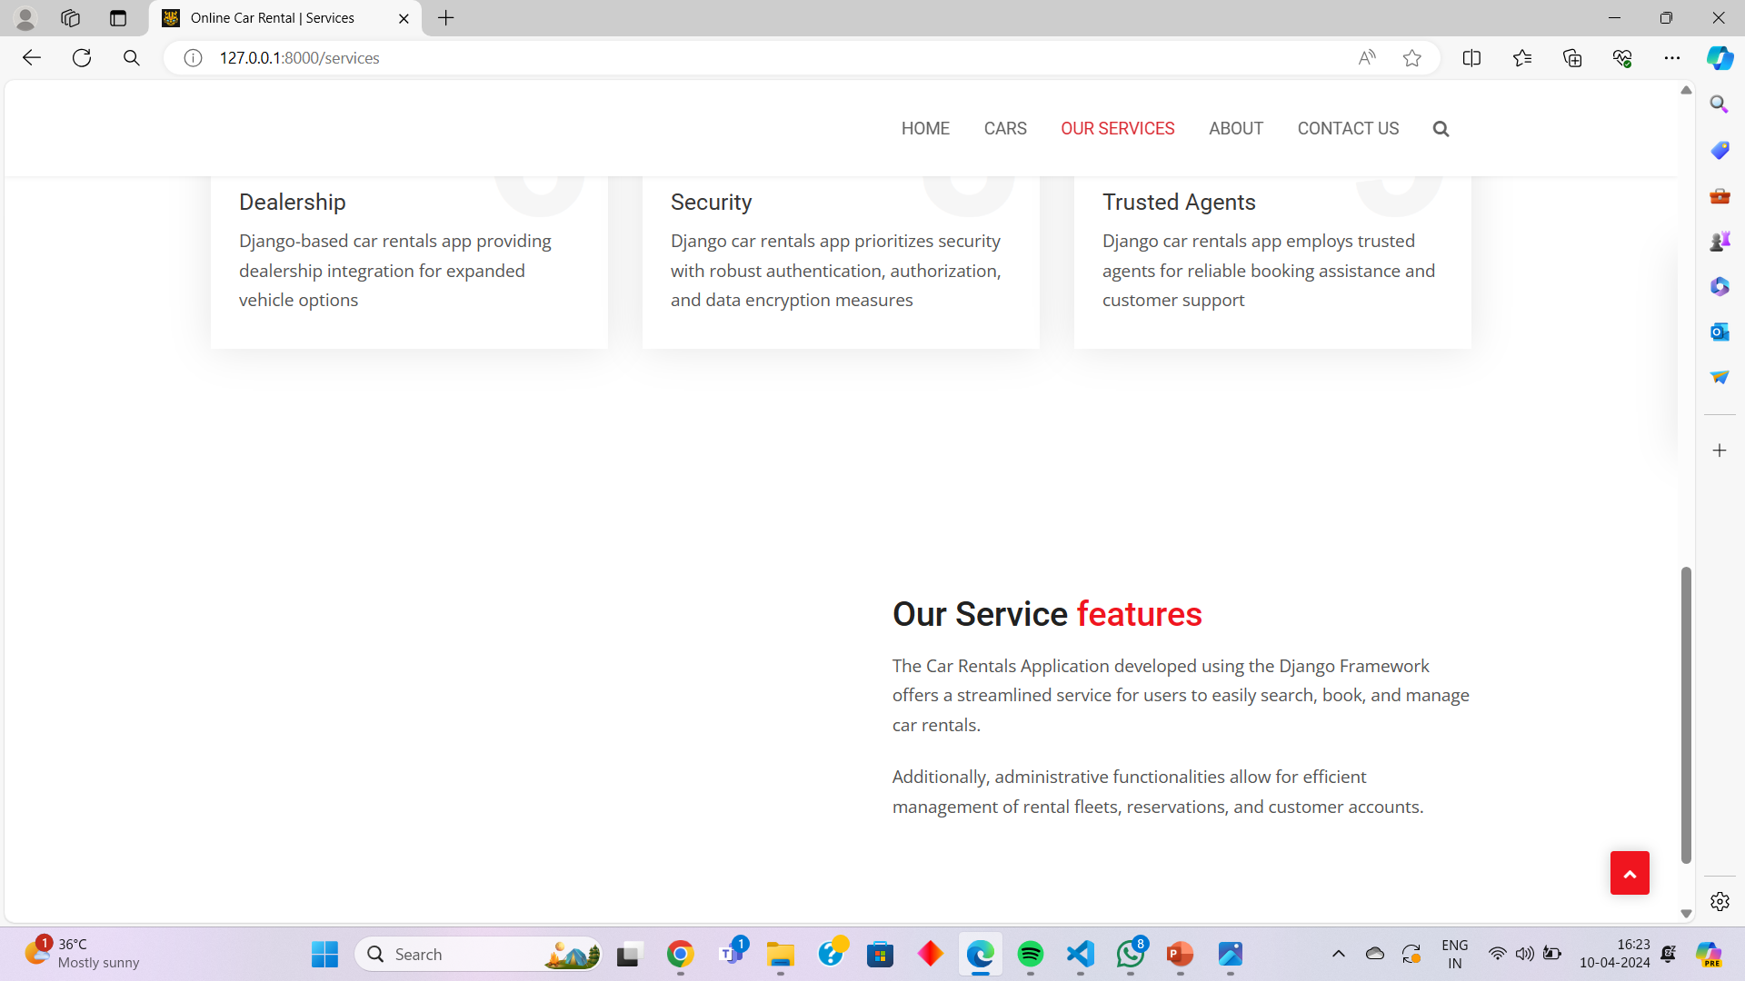
Service-Page

Slide 14
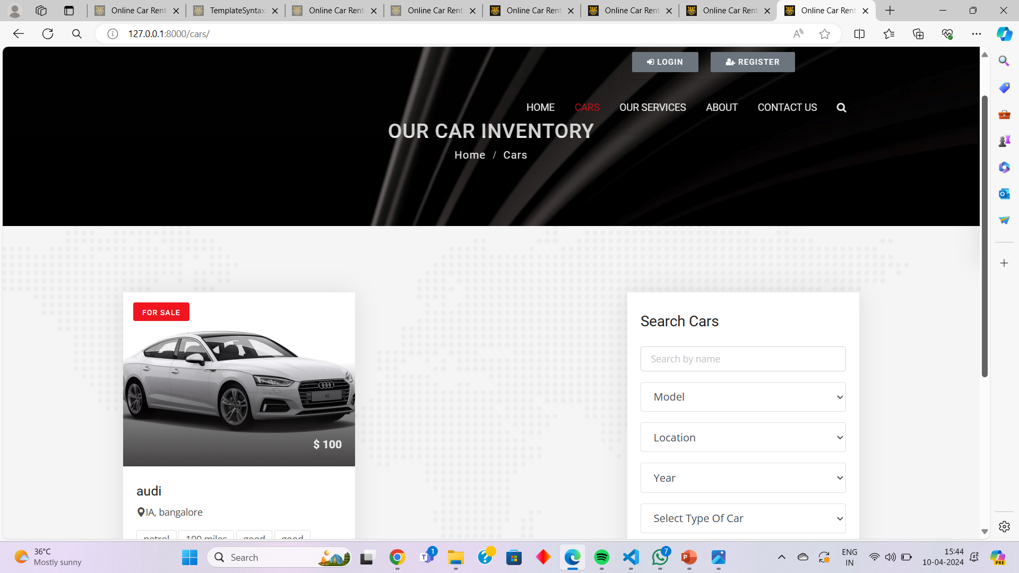
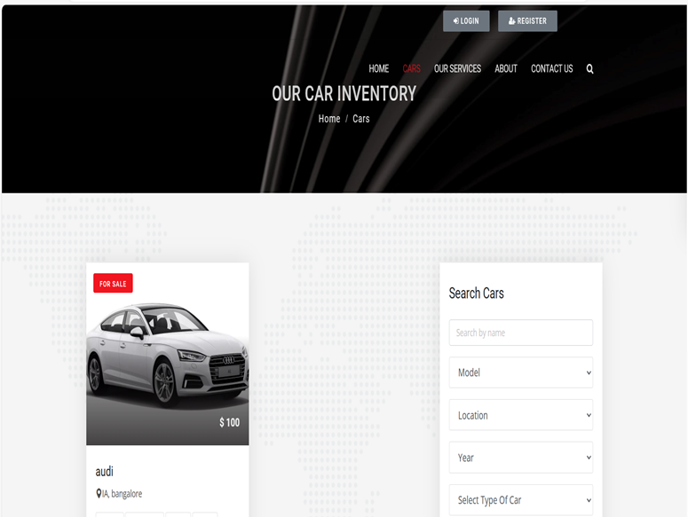
Cars

Slide 15
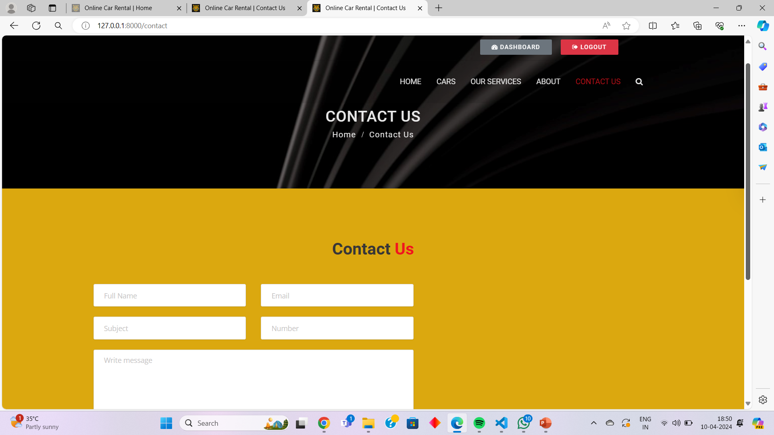
Contact Us
.

Slide 16
Future Enhancements:
Advanced Search Filters: Implementing sophisticated search filters to allow users to refine their rental options based on specific criteria such as vehicle type, fuel efficiency, and features.
Real-Time Vehicle Tracking: Integrating real-time vehicle tracking technology to enable users to monitor the location and status of their rented vehicle, enhancing convenience and security.
AI-Driven Recommendation Systems: Utilizing artificial intelligence algorithms to analyze user preferences and rental history, providing personalized rental suggestions tailored to individual needs.

Slide 17
Conclusion
In conclusion, the car rental application developed using the Django framework offers a comprehensive solution for both users and administrators. With features such as user authentication, car listings, booking system, admin panel, user profiles, and responsive design, it provides a seamless experience for renting cars online. By leveraging Django's robust capabilities, the application ensures reliability, security, and scalability, making it an ideal choice for businesses in the car rental industry.
Source :

Slide 18
Thank You!
Notes:
Thank You !!

